Slide 1

DESIGN FABRICATION OF A PEDALLING PADDY THRESHER
PROJECT PRESENTATION – JULY 2023
SUPERVISOR,
VIJAYASEKARAN
ASSISTANT PROFESSOR,
DEPARTMENT OF MECHANICAL ENGINEERING, RATHINAM TECHNICAL CAMPUS
PRESENTED BY,
KAVIYARASAN.M
GLADWIN JOHNDURAI.J
VASANTH KARUPPUSAMY.P
YOGESHGUNAL.C

Slide 2
ABSTRACT
The main objective of this study was to design and fabricate a pedal powered thresher for threshing, separating, and cleaning rice paddies.
The major components of the machine include threshing, separation and cleaning units.
Threshing operation is achieved by rotational motion of a cylinder fitted with beater spikes above a stationary grid which results in the removal of the paddies from the bulk straws.

Slide 3
INTRODUCTION
Rice (Oriza sp) is after wheat, the most widely cultivated cereal in the world and it is the most important food crop for almost half of the world’s population [1].
National rice consumption in Kenya is estimated at about 300,000 tonnes against an annual domestic production of between 45,000 to 80,000 tonnes.
This huge gap between consumption and production is met through importation of rice. In 2008, rice imports into Kenya were valued at Ksh 7 billion [2].

Slide 4
PROBLEM IDENTIFICATION
Today there are various machines for performing various kinds of operations in farm as well as for doing every work, where considering our research we have found for study i.e.”
Rice Threshing, here we found various problems that has to be noted and can be worked on. So this problems can be framed as the machines that are used for rice threshing are required more man power for threshing i.e.
if one labour standing with rice plant for threshing behind the thresher it’s difficult to rotate rice plant continuously in standing position with rice plant.

Slide 5
LITERATURE REVIEW
The main objective of this study was to design and fabricate a pedal powered thresher for threshing, separating, and cleaning rice paddies.
The major components of the machine include threshing, separation and cleaning units.
Threshing operation is achieved by rotational motion of a cylinder fitted with beater spikes above a stationary grid which results in the removal of the paddies from the bulk straws.

Slide 6
MATERIAL USED
S.No | DESCIRPTION | QTY | MATERIAL
1 | CHAIN DRIVE | 1 | STAINLESS STEEL
2 | DISC | 1 | MILD STEEL
3 | BEARING | 8 | STAINLESS STEEL
4 | FRAME | AS PER REQUIRMENT | MILD STEEL
5 | SHAFT | AS PER REQUIRMENT | MILD STEEL
6 | METAL STRIP | AS PER REQUIRMENT | MILD STEEL

Slide 7
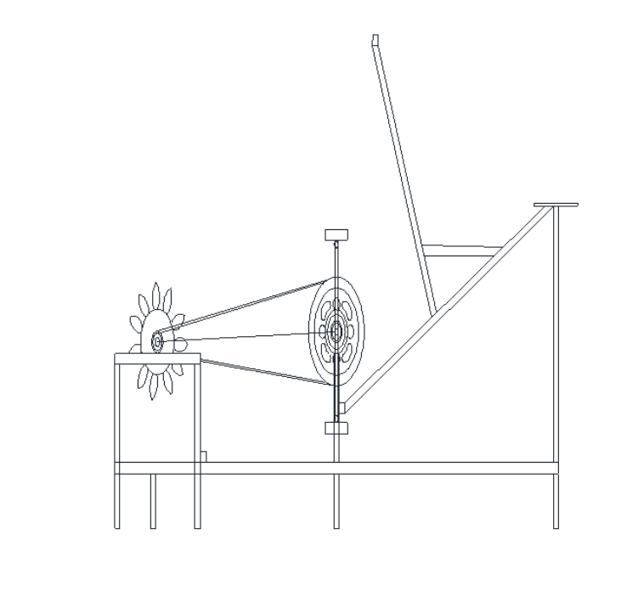
DESIGN
SHAFT
METAL STRIP
BALL BEARING
SPROCKET
DISK
METAL FRAME

Slide 8
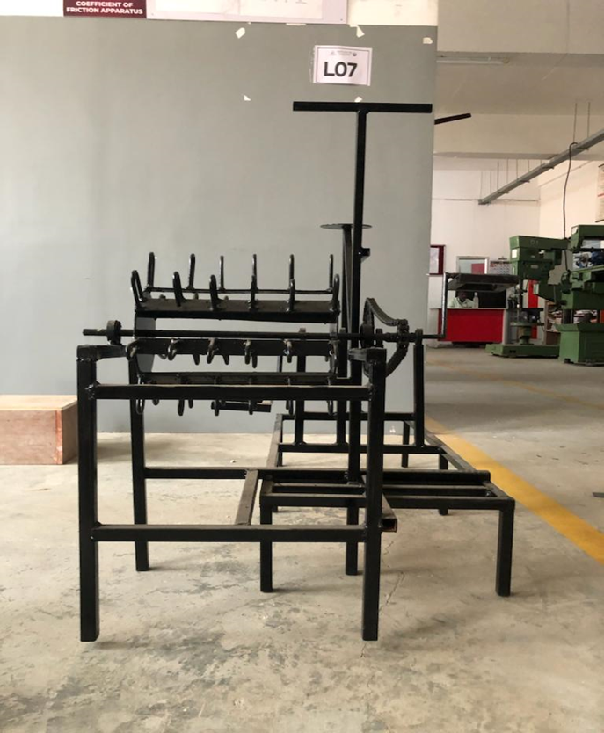
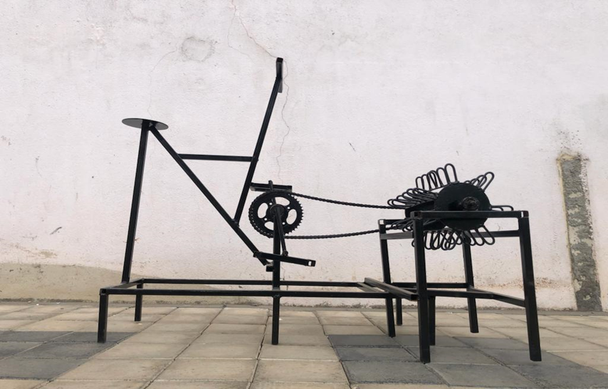
PHOTOGRAPHY

Slide 9
WORKING MODEL
The threshing component works on the principle of impact force, while the screen uses the principle of reciprocating motion to cause the agitation of the paddy grain.
The larger sprocket transmits rotary motion to another smaller sprocket mounted on a second shaft thus causing the shaft to rotate an increased speed.
This second shaft has a sprocket of same size mounted on it and is connected to the shaft at the threshing unit.

Slide 10
COST ESTIMATION
SL.NO | DISCRIPTION | COST Rs:
1 | WELDING MACHINE | 1000
2 | GRINDING MACHINE | 1500
3 | CUTING MACHINE | 1000
4 | WELDIJNG ROD | 650
5 | CUTTING WHEEL | 350
6 | PINT AND BRUSH | 500
7 | CHINE AND BEARING | 600
8 | METAL PLATE | 400
9 | METAL SQUARE TUBE | 1800
10 | METAL BENDING | 800
11 | SPROCKET | 400
 | TOTAL | 9000

Slide 11
REFERENCE
Rice Policy-World Rice Statistics (WRS). International Rice Research Institute, IRRI web. http://www.irri.org/science/ricestat, 2009.
National rice development strategic plan Government of Kenya, Ministry of Agriculture, 2016.
Earth trends 28 (2) : 37 – 40 , (2018) web. http://www.earthtrendswri.org/pdf_ library/feature/agr_fea_ dissapear pdf .

Slide 12
THANK YOU

